Slide 1
Management 515
Continuous Process Improvement
© 2015, 2016 David E. Frick.
All rights reserved.

Slide 2
Definitions
A continual improvement process, also called continuous process improvement (CPI), is an ongoing effort to improve products, services, or processes. These efforts can seek improvement over time (evolutionary) or breakthrough (revolutionary) improvement. Customer-valued processes are constantly evaluated and improved in the light of their efficiency, effectiveness, and flexibility.
In American English, common usage suggests that the word "continuous" should be used for things that are literally or figuratively unbroken over time (as in a continuous function), whereas the word "continual" should be used for things that continue in discrete jumps. When this distinction is enforced, it is more accurate to speak of continual processes improvement than of continuous process improvement.
2

Slide 3
Core of All Improvement Processes
3
Notes:
All continuous process improvement (CPI) processes include these four steps its core.
PLAN. Establish the objectives and processes necessary to deliver results in accordance with the expected output (the target or goals).
DO. Implement the plan, execute the process, make the product. Collect data for charting and analysis in the following "CHECK" and "ACT" steps.
CHECK. Study the actual results and compare against the expected results (targets or goals from "PLAN") to ascertain any differences. Look for deviation in implementation.
ACT. If the CHECK shows that the PLAN that was implemented in DO is an improvement to the prior standard (baseline), then that becomes the new standard (baseline) and the next iteration begins. If the CHECK shows that the PLAN that was implemented in DO is not an improvement, then the existing standard (baseline) will remain in place.

Slide 4
Common CPI Principles
Process Improvement Plan – “Without a plan, you do not know where you are going.” The Project Management Institute Project Management Book of Knowledge (PMBOK) recommends every process improvement plan run alongside actual project phases. A good plan will be specific on goals and expectations
Process for Improving – This principle ensures a process is set up for improvement. For example, will X-Bar control charts be used to determine acceptable and non-acceptable levels within a project or will the PDCA be employed?
Root Causes – Improvements must detect and correct root causes. Fault tree diagrams are often used to identify root causes in order for issues to be controlled or improved.
Monitoring Improvements – This may be the most useful part of CPI as it ensures improvements are not lost through “regression to the former”
Developing Quality Assurance Plans – View QAPs as lessons learned and a method for codifying techniques
4

Slide 5
Critical Factors
Strong executive leadership
Clear and measurable goals
Alignment of business case and performance measures
Clearly defined roles and responsibilities
Customer focus (Voice of the Customer)
Change must be part of the culture
Notes:
Strong executive leadership. Without executive involvement to “champion” an effort, process improvement is normally doomed to failure. People resist change. If the people believe that the boss does not care, the initiators of change will be ignored and sometime consciously opposed.
Clear and measurable goals. If you do not know where you are gong, any path will get you there.
Alignment of business case and performance measures. Change usually has a cost. If the change cannot be justified in a business case, then change should not be attempted (unless the change is mandated by some authority).
Clearly defined roles and responsibilities. This is the same as with any project-oriented effort. In many cases, a change effort can be viewed as a time-bound project. The same project principles apply.
Customer focus (Voice of the Customer). The most common mistake made in change efforts is not including the customer in the process. The customer could be the buyer of products, an internal customer (e.g., all employees are customers of the payroll department), or some stakeholder, (e.g., the IRS is a customer of tax filings).
Change must be part of the culture. Change is hard. People resist change. Unless the people see a benefit (meaning the change is good for me), change will be resisted. The leadership team that can inculcate the idea of change and improvement in the culture of the firm will be the most successful.

Slide 6
Most Popular
Continuous Improvement Method | Popularity
Lean manufacturing | 40.5%
Lean and Six Sigma | 12.4%
Total quality management | 9.9%
Agile manufacturing | 3.8%
Toyota Production System | 3.1%
Six Sigma | 3.1%
Theory of Constraints | 3.0%
Other | 5.2%
No Methodology | 19.1%
Source: IndustryWeek, 9 April 2007

Slide 7
Flavors of CPI
Six Sigma
Lean
Lean Management
Lean Six Sigma
BPR
ISO 9000-2000
ISO/IES 2000
Quality
Total Quality Management
Just in Time
Kaizen
Agile Management
Hoshin Planning
Poka-Yoka
Design of Experiments
Process Excellence
Theory of Constraints
7
Notes:
Here is a list of CPI methodologies with which I am familiar. Each is best for some types of change and each specific change effort has a best suited method.
Sadly, few change practitioners are familiar with more than a few methods. Firms end up using the method that is most familiar (or cheapest) instead of the best suited.

Slide 8
Lean Six Sigma
DMAIC
Define. Clearly describe process(es)
Measure. Collect data
Analyze. Anything out of tolerance?
Improve. Reduce variation, waste, or non-value added sub-processes
Control. Don’t allow the process to regress to the old norm
8
Notes:
I am most familiar with Lean Six Sigma (LSS). In fact, I am an LSS Black Belt.
LSS is useful for data-intensive process where a normal range of acceptability is present. In processes where data are not definable or easily obtainable, LSS may not be the most suitable method.
The Department of Defense has adopted LSS as it official (and only) CPI method. For the DoD, all problems are nails that must be driven with the LSS hammer.
Many firms suffer from this same shortsightedness.

Slide 9
Capability Maturity Model Integration
Capability Maturity Model Integration (CMMI) is a process improvement training and appraisal program and service administered by Carnegie Mellon University (CMU) and required by many DoD and U.S. Government contracts, especially in software development. CMU claims CMMI can be used to guide process improvement across a project, division, or an entire organization. CMMI defines five maturity levels for processes:
Initial—We have unpredictable processes
Managed—We have reasonably predictable processes
Defined—We follow well codified processes
Quantitatively Managed—We measure and control our processes
Optimizing—We use CPI
9
Notes:
CMMI is not so much a CPI method as a way to evaluate how mature your firms process are.
Few firms ever achieve level 5 and those that do seldom retain that rating beyond the next evaluation.
The U.S. Congress several years ago implemented a rule that required that any company that does business with the federal government must be CMMI level 3 or better. So few companies are able to obtain that rating, that the rule was eventually rescinded.

Slide 10
CMMI Level 5 – United States
Parent Company | Element(s) | Type
CACI International, Inc. | Logistics and Material Readiness Division | DEV v1.3
General Atomics Aeronautical Systems, Inc. | Aircraft Systems Group; Full directed Programs; Systems and Software; Development and Production | DEV v1.3
General Dynamics Mission Systems | Maritime & Strategic Systems | DEV v1.3
Hewlett Packard Enterprise | US Public Sector CECE High maturity Organization | DEV v1.3
Hewlett Packard Enterprise | US Public Sector Medicare Systems High Maturity Organization | DEV v1.3
HPE Enterprise Service | HPE TennCare Account | SVC v1.3
RelayHealth Corporation | Pharmacy Solutions | DEV v1.3
US Army ARDEC Armament SEC | ARDEC Armament Software Engineering Center | DEV v1.3

Slide 11
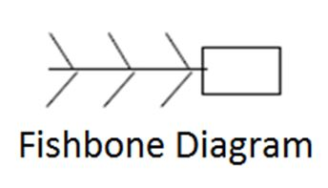
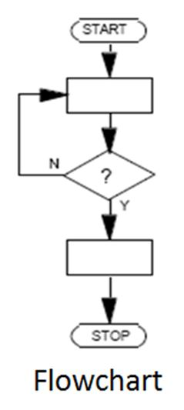
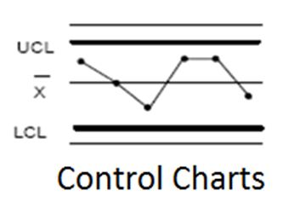
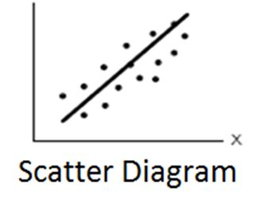
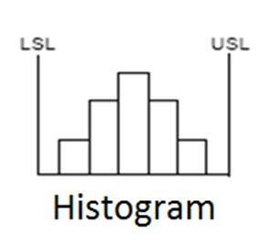
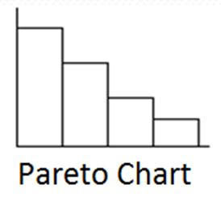
Process Improvement Tools
Notes:
If you are not familiar with this toll, please look at the Wikipedia page.
Flowcharts: https://en.wikipedia.org/wiki/Flowchart
Pareto charts: https://en.wikipedia.org/wiki/Pareto_chart
Scatter diagram: https://en.wikipedia.org/wiki/Scatter_plot
Control charts: https://en.wikipedia.org/wiki/Control_chart
Histogram: https://en.wikipedia.org/wiki/Histogram
Fishbone diagram: https://en.wikipedia.org/wiki/Ishikawa_diagram

Slide 12
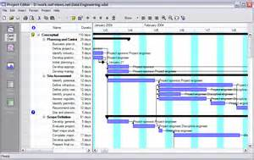
Gantt Charts
12
Notes:
Gantt charts: https://en.wikipedia.org/wiki/Gantt_chart

Slide 13
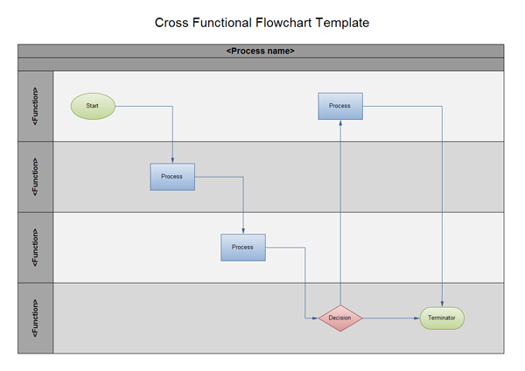
Visio Swim Lane Diagrams
13
Notes:
Swim lane diagram: https://en.wikipedia.org/wiki/Swim_lane

Slide 14
Final Thoughts
CPI is a mindset
The tools, techniques, and methods are only useful, if they are useful
Don’t force a square peg into a round hole
Unless the culture supports CPI, any improvements will be lost over time
Change for change’s sake is not improvement

